Slide 1
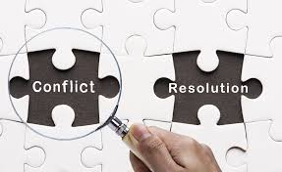
Week 7 Managing Intercultural Conflicts

Slide 2
Learning objectives
At the end of this lecture, you should be able to:
Identify different sources of conflicts.
Describe stages in the conflict process.
Recognise the influence of culture on conflict management strategies.

Slide 3
Define conflict
Conflict refers to the interaction of interdependent people who perceive opposition of goals, aims, and values, and who see the other party as potentially interfering with the realisation of these goals.

Slide 4

Characteristics of conflict
Three general characteristics of conflict:
- incompatible goals
- interdependence of the parties involved
- communication

Slide 5
Stages in the conflict process
Latent conflict: incompatibilities and interdependence exist between the parties.
Perceived conflict: one or more of the parties believe that incompatibilities exist.
Felt conflict: the parties begin to formulate strategies about how to deal with the conflict.
Manifest conflict: Strategies and goals are enacted in communication.
Conflict aftermath: both short-term and long-term consequences of conflict.
Reference
Pondy, L. R. (1967). Organizational conflict: Concepts and models. Administrative Science Quarterly, 12, 296-320.

Slide 6
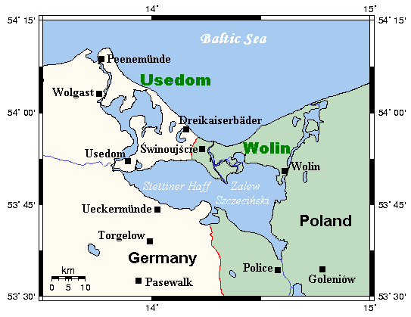
The case of Usedom: Polish and German island

Slide 7
Critical thinking
Do conflict prevention agencies have the power, or the right, to move a country or region along the continuum from ongoing conflict to durable peace?

Slide 8
Questions for thinking
The process of “dealing with the past” for a conflict-ridden country usually needs to happen on a number of different levels, from the micro-level of an individual to the macro-level of national, regional and international political bodies.
Can you identify some challenges that a country might face in “dealing with the past”?

Slide 9
Culture and conflict management
The way people understand conflict situations, what they choose to privilege in them, and the elements that resonate more strongly with them are influenced by their cultural frames of reference.
Cultural orientations influence choice of conflict management strategies, mediation, and negotiation.

Slide 10
Conflict as normal approach
Conflict as normal approach views conflict as an opportunity to grow and to develop closer relationships. Based on four main assumptions:
Conflict is normal and useful;
All issues are subject to change through negotiation;
Direct confrontation is valued; and
Conflict always represents a renegotiation of contract, a release of tensions and a renewal of relationships.
Augsburger, D. (1992). Conflict mediation across cultures. Louisville, KY:
Westminster/John Knox Press

Slide 11
Conflict as destructive approach
Conflict as destructive approach views conflict as unproductive and dangerous for relationships. Based on four assumptions:
Conflict is a destructive disturbance to peaceful situations;
The social system should not be adjusted to the needs of its members: rather, its members need to adapt to the established values;
Confrontations are destructive and ineffective; and
Agents should be disciplined.

Slide 12
Conflict management strategies
High
Self face concern
Competing
Collaborating
Compromising
Avoiding
Accommodating
Low
High
Other face concern
Ting-Toomey’s (2005) two-dimensional model, see reference in the lecture notes.

Slide 13
Managing intercultural conflict
The following are proposed as strategies to effectively
manage intercultural conflict:
Focus on common ground and reduce disagreement.
Practise relational empathy.
Develop a positive communication climate.

Slide 14
After class
Visit a webpage of the United Nations at http://www.un.org/en/about-un/.
Search for information on where the UN is currently taking action on racial conflicts. Choose one country as your case study. Identify the source of the racial conflict and the steps that are being taken to alleviate it.

Slide 15
Next week
Next week will focus on developing relationships with immigrants and refugees.

